Slide 1
Intelligent Systems Final Project: Snake Game AI using Deep-Q Reinforcement Learning
Group: Almada Putra, Gadtardi Wongkaren, Michael Joseph, Mika Mahaputra

Slide 2
Introduction
What is Machine Learning?
It is a branch of AI and computer science which focuses the use of data and algorithms to imitate how a human learns gradually.
What is Deep Learning?
Deep Learning is a subfield of machine learning which is more concerned with algorithms correlated with artificial neural networks.

Slide 3
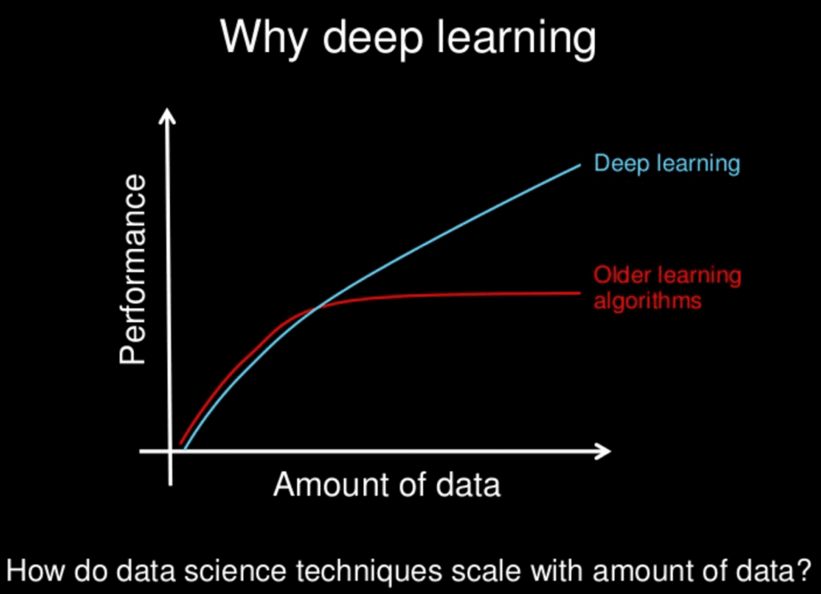
Deep Learning
It is called “Deep” because it refers to the large number of layers in the neural network.
Neural Networks get better with more data, bigger models, more computations.
Deep learning excels on problem domains where the inputs (and even output) are analog. Meaning, they are not a few quantities in a tabular format but instead are images of pixel data, documents of text data or files of audio data.

Slide 4
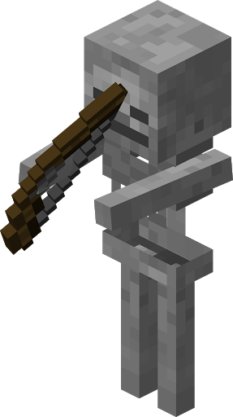

Deep Learning in Games
Deep Learning has been in video games for a while, from non-player characters (NPC) like mobs in Minecraft to chess playing bots like AlphaZero

Slide 5
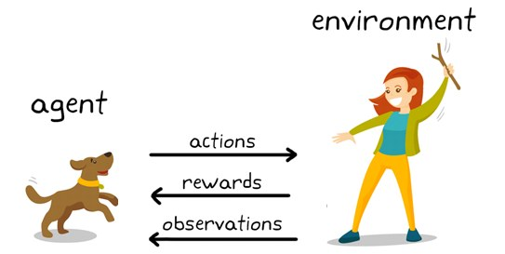
What is Reinforcement Learning?
Reinforcement Learning (RL) is an area of machine learning concerned with how intelligent agents take actions in an environment in order to maximize a reward.

Slide 6
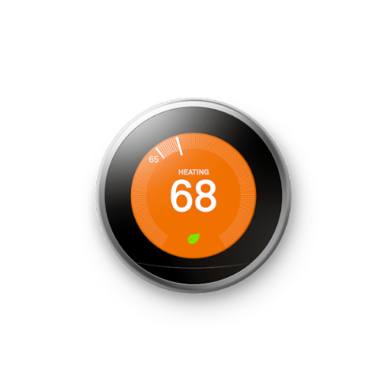
What is an Intelligent Agent?
An intelligent agent (IA) refers to an entity which acts in order to achieve certain goals in an environment.
It uses sensors and consequent actuators to achieve these goals.
Intelligent agents can learn or use previous knowledge to help achieve their goals.
Example: Thermostat maintaining a temperature of 16°C

Slide 7
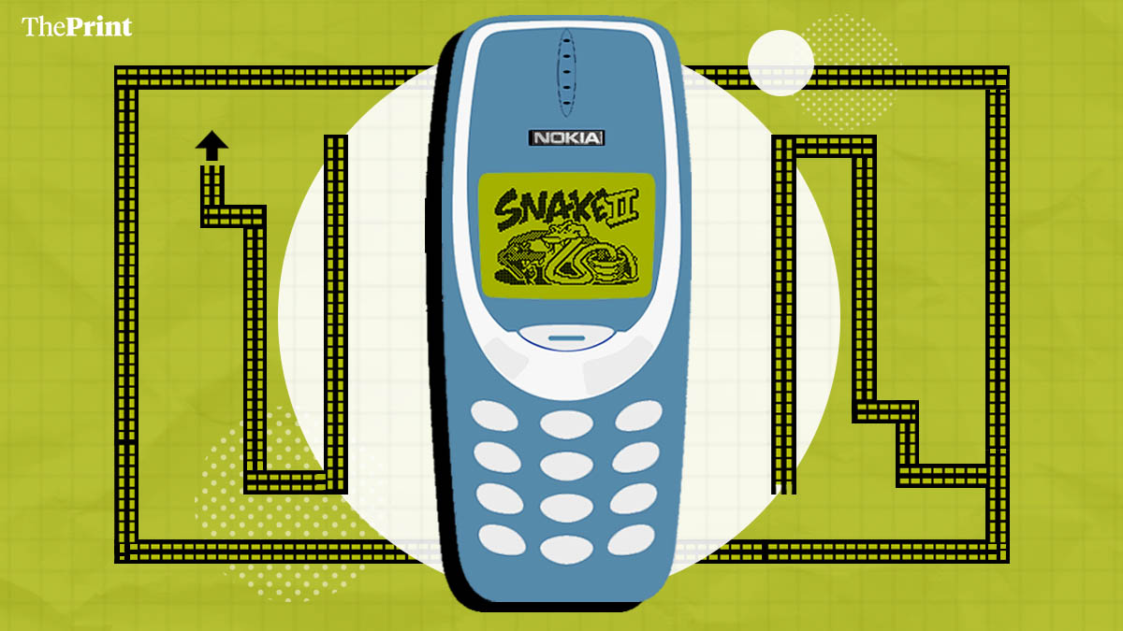
The Problem
For this project we aim to apply our knowledge on deep learning, artificial neural networks and python in order to develop a working intelligent agent for the snake game.

Slide 8
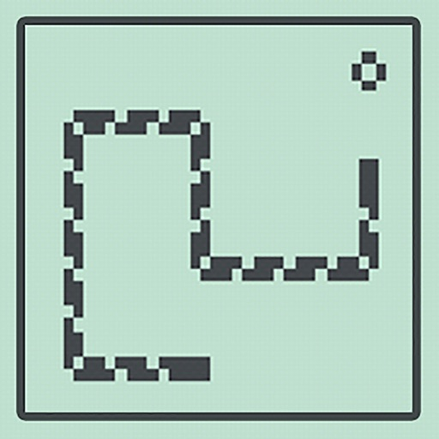
Classic Snake Game Constraints/Rules
Snake begins at length 1
Snake spawns in a square grid (typically 30x30)
Snake can move straight, left, right
Snake has to eat food to gain a point and its length by 1
Food respawns after being eaten.
Snake must not hit the boundary or itself.

Slide 9
What is Our Solution?

Slide 10
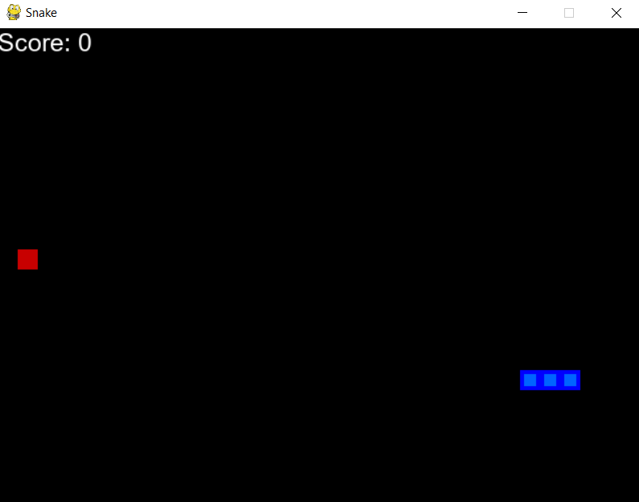
Our Environment
Our Snake Game Environment will be created with the python library Pygame.
The board will be initialized with a width of 640 and a height of 480
Spawn food in random locations
Initialize a snake with length 1
Perform actions according to the agent

Slide 11
Our Intelligent Agent
Extending our Deep Learning into Deep Q Learning which utilizes a Q (quality of action value) in order to train our model. The python Library we are using for the Neural Network and the will be Pytorch
Pytorch has packages and modules like torch.nn, torch.optim, and torch.nn.Functional in order to create, optimize and train a neural network model.

Slide 12
Q value (Quality of Action)
The Q-Value is the maximum expected reward an agent can reach by taking a given action A from the state S.
When the program is run, a q-value is initialized and be constantly updated in order to improve the agent’s performance when re-training the model.

Slide 13
Q value (Quality of Action)
S = the State or Observation
A = the Action the agent takes
R = the Reward from taking an Action
t = the time step
Ɑ = the Learning Rate
ƛ = the discount factor which causes rewards to lose their value over time so more immediate rewards are valued more highly

Slide 14
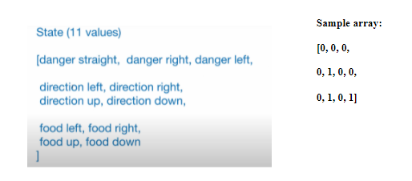
Our Intelligent Agent
Intelligent Agents will have states that will serve as the input that will be fed into the neural network.
The state will be an array of 11 binary values which correspond to an attribute about the environment.

Slide 15
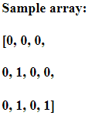
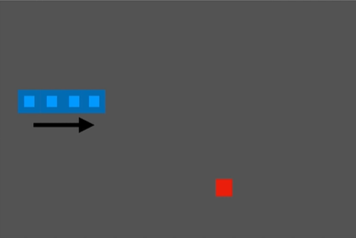
Sample Array Translation

Slide 16
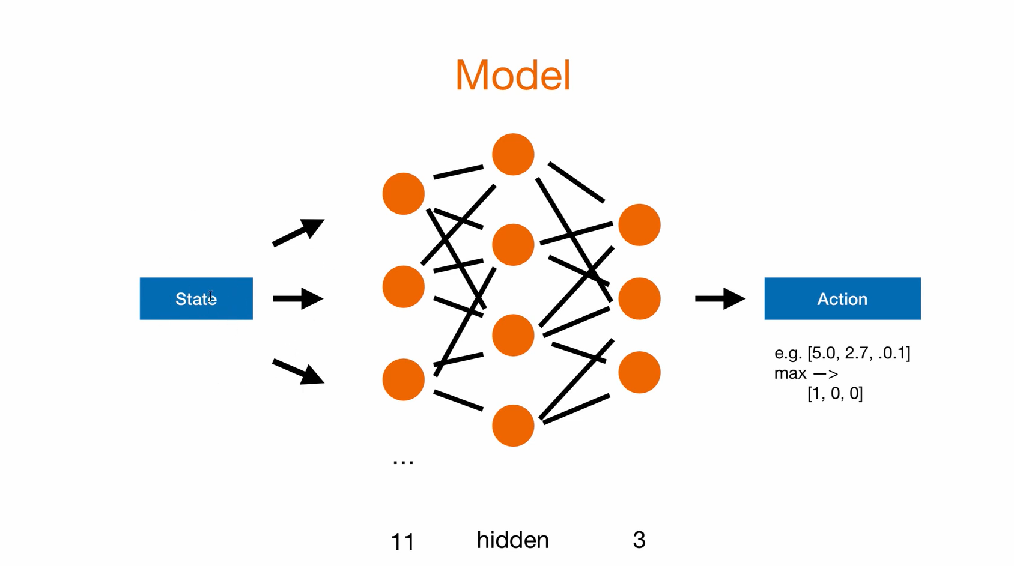
Neural Network Model

Slide 17
Model Output
As we can see from the previous image, the model will transform the 11 sized array into a array with size 3 with the values [5.0, 2.7, 0.1].
The array of size 3 will be processed again so that only the index with the maximum value will be turned into an on bit (1) and the rest be turned off (0)
[5.0, 2.7, 0.1] -> [1,0,0]

Slide 18
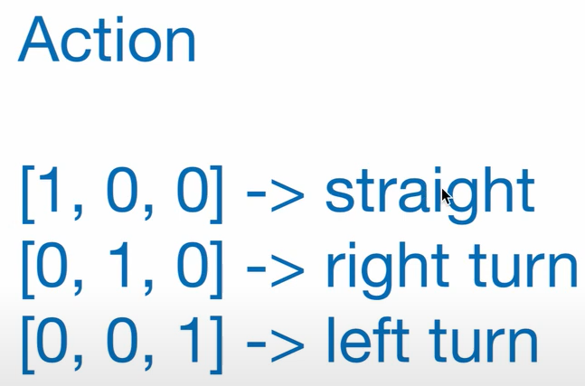
Model Output
The array is now converted into a performable action by the agent.

Slide 19
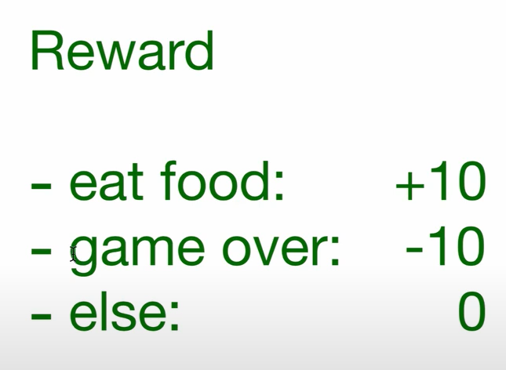
Rewards
After the action is performed the reward will be measured.
The agent will get +10 reward if it eats the food, and -10 reward if the game ends, anything else in between (moving across the board) gets no reward.

Slide 20
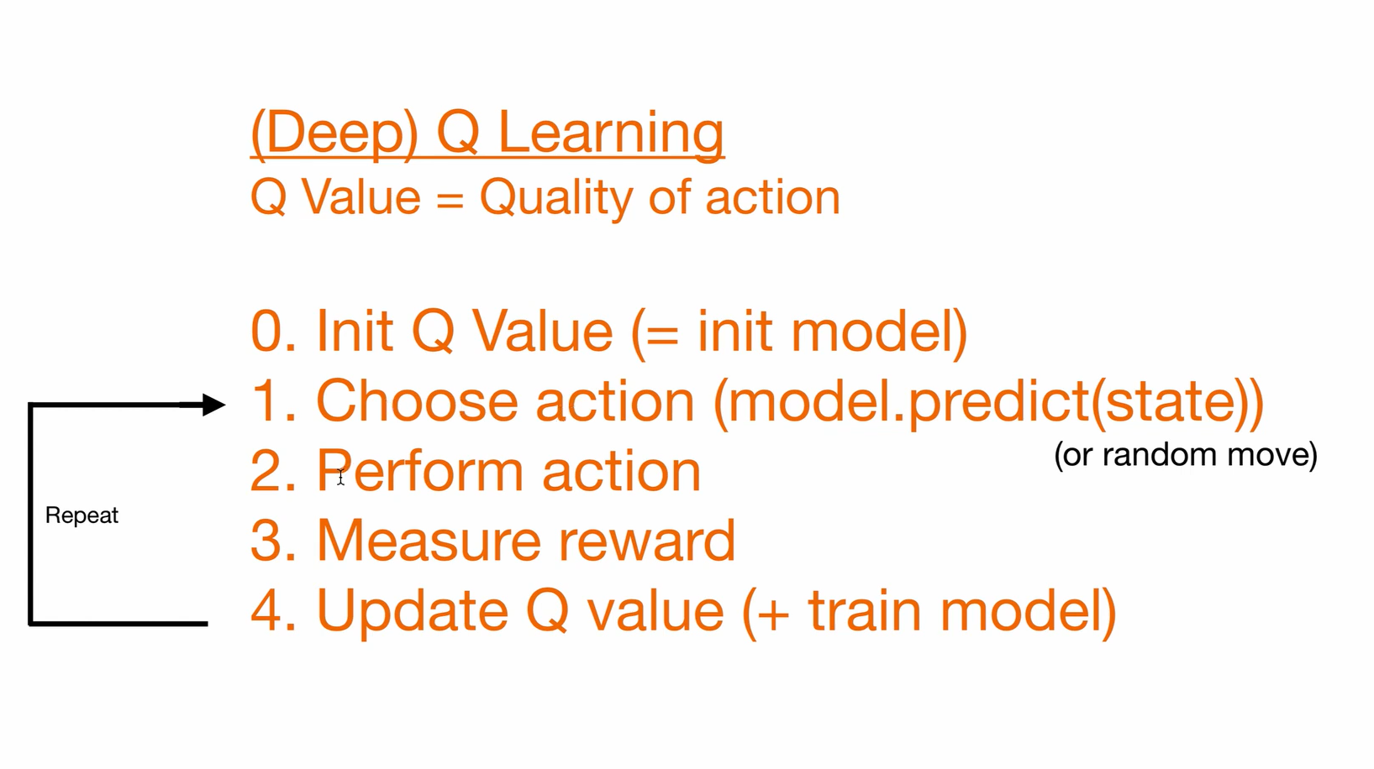
Update Q Value
For the final step, the Q value is updated using Bellman Equation described earlier and the cycle repeats.

Slide 21
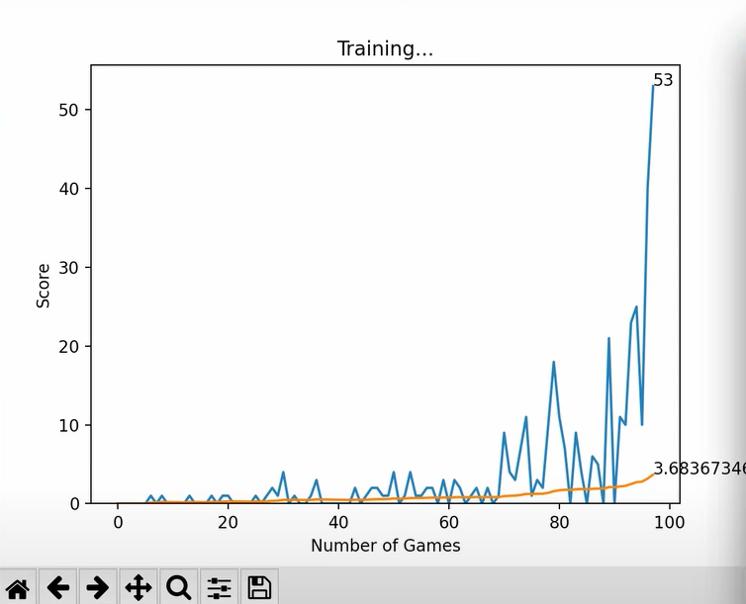
Performance Analysis
Finally, matplotlib is used for this project’s performance analysis. The data received during the agent’s training is clearly displayed and plotted on a graph and updated constantly using matplotlib. As we can see from the image the graph plots an x-axis of the number of games, against the score which is achieved each game. With this information, we can see the progress of the agent as it “learns” to play the game.
Orange line indicates the average score so far.

Slide 22
Conclusion

Slide 23
Conclusion
After training the agent for around 10-12 minutes it is able to play the game efficiently, reaching scores up to 61 with an average score of 4.26
However, there are still issues where the snake still loses and sometimes gets stuck in an infinite loop or gets the food in inefficient ways and wasting a lot of moves in order to get the food.
This could possibly be improved by implementing some hamiltonicity rules into the code so that the snake gets stuck less often.

Slide 24

Thanks for Listening!

